Slide 1
Lab 4 Abstract Factory Patterns
Please download the corresponding materials

Slide 2
Before introducing the lab, please pay attention to the following issues:
1, sign in the attendance sheet (20% point deduction for absence);
2, the due (02/21/2018);
3, demo: any labs or office hours before the deadline (redemo is okay); our next lab (02/22/2018) (redemo is not allowed)
4, next office hour: Tuesday 2:00 – 4:00 P.M (02/20/2018, Monday is holiday)
5, submission: push code on Github repo, screenshot of your Github on iLearn
6, introduce: Abstract Factory Pattern, implement based on Lab 3

Slide 3
Print Classes
Print Classes: print double value in different formats
DoublePrint: print double value in original format
HexPrint: print double value in hex format
BinaryPrint: print double value in binary format

Slide 4
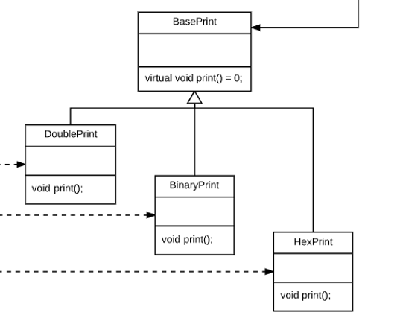
Print Classes
Notes:
Any questions so far?

Slide 5
Factory Classes
Printer Factory: generate different types of printers above
BaseFactory: base class, also abstract factory
DoubleFactory: generate DoublePrint
HexFactory: generate HexPrint
BinaryFactory: generate BinaryPrint

Slide 6
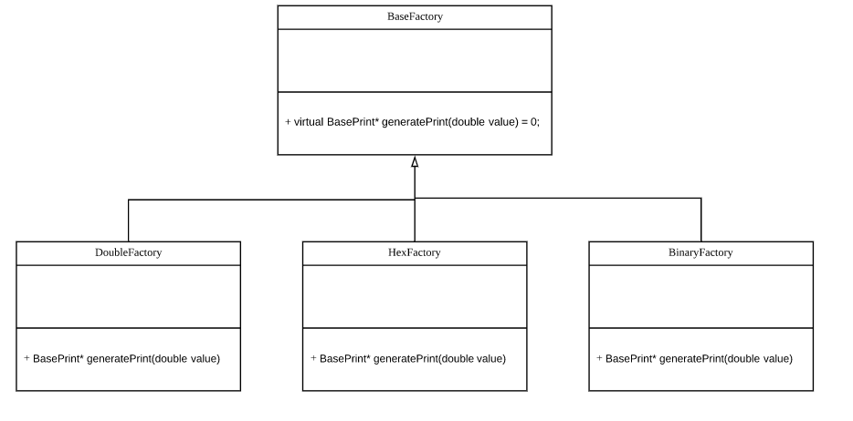
Factory Classes

Slide 7
For Containers in Lab 3
Modified print() function can print values of trees in different formats
Constructor of Container accepts BaseFactory* as input parameter
Rewrite print()
Use factory to generate Printers
Use Printer to print out values in relevant formats

Slide 8
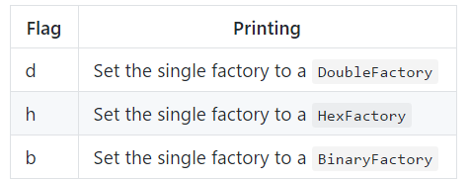
Testing Program
Use different parameters in command line to tell program which type of Factory object will be created

Slide 9
Testing Program
Test all types of factories and printers
Test print() for both VectorContainer and ListContainer
After log onto hammer, don’t forget to run following command to update latest version of tools
source /opt/rh/devtoolset-6/enable
5. Use -std=c++11 compiler flag to compile your program
6. HexPrinter may not get the correct format due to the compile environment on hammer. Don’t worry as long as your code is correct.

